Slide 1
Spacecraft Formation Flying Using Sliding Mode Control
Maggie Lawn
Air Force Research Laboratory Mentors/Collaborators:
Chau Ton and Morgan Baldwin

Slide 2
Outline
Introduction to Formation Flying
Introduction to Sliding Mode Control
Objective of Project
Dynamics Model
Classical Sliding Surface
Alternative Sliding Surfaces
Nonsingular Terminal Sliding Surface
Simulations
Conclusions
Experiment

Slide 3
Outline
Introduction to Formation Flying
Introduction to Sliding Mode Control
Objective of Project
Dynamics Model
Classical Sliding Surface
Alternative Sliding Surfaces
Nonsingular Terminal Sliding Surface
Simulations
Conclusions
Experiment
Notes:
“formation flying”: two or more satellites that have to track and maintain a desired relative trajectory and/or a relative orientation

Slide 4
Formation Flying
Benefits:
Robustness to faults
Versatility
Cost
Past and planned missions using formation flying:
Earth science missions: CLUSTER, GRACE, and TanDEM-X
Space science missions: MMS, Stellar Imager, EXO-S
Technology demonstration missions: PRISMA
Notes:
CLUSTER uses a four-satellite formation to study the interactions between solar wind and the Earth’s magnetic field [1]. The GRACE mission uses two identical satellites to develop a high-fidelity model of Earth’s gravitational field [2]. TanDEM-X is a two-satellite mission for the generation of a high-fidelity digital elevation model of the surface of the Earth [3]. MMS uses four satellites in a tetrahedral formation to study the Earth’s magnetosphere [4]. Stellar Imager is a space-based ultraviolet/optical interferometer which uses a formation of 20+ small mirror satellites and a chief hub to study solar and stellar magnetic activity [5]. EXO-S is a two-satellite space-based telescope for the discovery and study of planets [6]. PRISMA is a technology demonstration mission using 2 satellites to qualify formation flying and rendezvous sensors and software

Slide 5
Robust Control for Formation Flying
Multiple satellite system dynamics models can be complex
Simplified models are less accurate
Thrust and parametric uncertainties due to long-term operations or hazardous conditions
Notes:
Why Use?
to guarantee formation fidelity via adequate formation control and stability without overtaxing onboard processing power, robust control algorithms can be used compensate for uncertainty and improve performanc

Slide 6
Outline
Introduction to Formation Flying
Introduction to Sliding Mode Control
Objective of Project
Dynamics Model
Classical Sliding Surface
Alternative Sliding Surfaces
Nonsingular Terminal Sliding Surface
Simulations
Conclusions
Experiment

Slide 7
Sliding Mode Control
Popular due to design simplicity and robustness to disturbances
2 steps:
Design of sliding variable
Choice of control to drive dynamics to sliding surface
Many sliding variable and control technique pairs exist

Slide 8
Outline
Introduction to Formation Flying
Introduction to Sliding Mode Control
Objective of Project
Dynamics Model
Classical Sliding Surface
Alternative Sliding Surfaces
Nonsingular Terminal Sliding Surface
Simulations
Conclusions
Experiment

Slide 9
Objective
Apply novel nonsingular terminal sliding mode controller to spacecraft formation flying
Prove robustness to uncertainty and disturbance
Present simulation and experiment results

Slide 10
Outline
Introduction to Formation Flying
Introduction to Sliding Mode Control
Objective of Project
Dynamics Model
Classical Sliding Surface
Alternative Sliding Surfaces
Nonsingular Terminal Sliding Surface
Simulations
Conclusions
Experiment

Slide 11
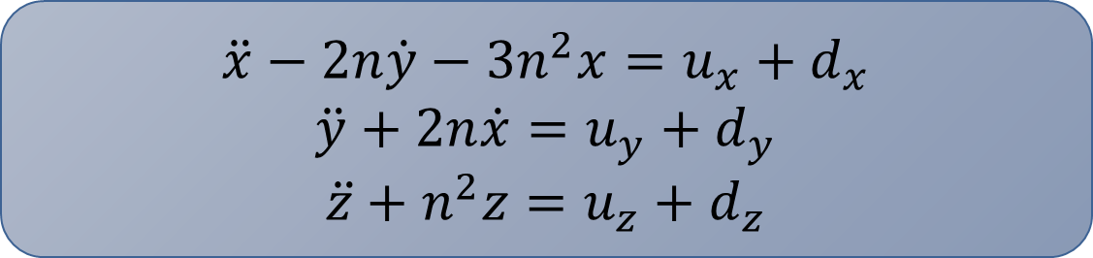
Dynamics
2 satellites, called “chief” and “deputy”
Assumptions: circular chief orbit and small separation distance between satellites
Clohessy-Wiltshire equations can be used to describe the relative motion
$$\ddot{x}−2n\dot{y}−3n^{2}x=u_{x}+d_{x}$$
$$\ddot{y}+2n\dot{x}=u_{y}+d_{y}$$
$$\ddot{z}+n^{2}z=u_{z}+d_{z}$$
Notes:
where $n$ is the chief’s orbital rate; $u_{x}$, $u_{y}$, and $u_{z}$ are the control inputs; and $d_{x}$, $d_{y}$, and $d_{z}$ are the matched disturbances in the LVLH directions

Slide 12

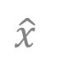
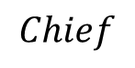
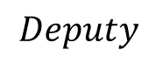
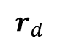
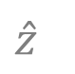
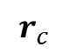
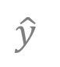
Dynamics
$$Deputy$$
Local Vertical Local Horizontal
Reference Frame
$$r_{d}$$
$$\hat{y}$$
$$\hat{z}$$
$$\hat{x}$$
$$Chief$$
$$r_{c}$$

Slide 13
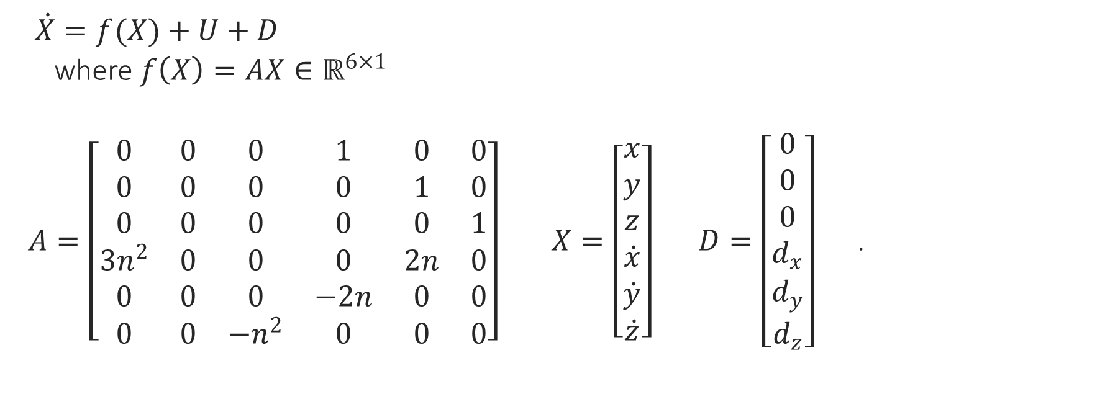
Dynamics
$\dot{X}=f(X)+U+D$
where $f\left(X\right)=AX∈ℝ^{6×1}$
$A=\left[\begin{matrix}0 & 0 & 0 & 1 & 0 & 0 \\ 0 & 0 & 0 & 0 & 1 & 0 \\ 0 & 0 & 0 & 0 & 0 & 1 \\ 3n^{2} & 0 & 0 & 0 & 2n & 0 \\ 0 & 0 & 0 & −2n & 0 & 0 \\ 0 & 0 & −n^{2} & 0 & 0 & 0\end{matrix}\right] X=\left[\begin{matrix}x \\ y \\ z \\ \dot{x} \\ \dot{y} \\ \dot{z}\end{matrix}\right] D=\left[\begin{matrix}0 \\ 0 \\ 0 \\ d_{x} \\ d_{y} \\ d_{z}\end{matrix}\right]$ .

Slide 14
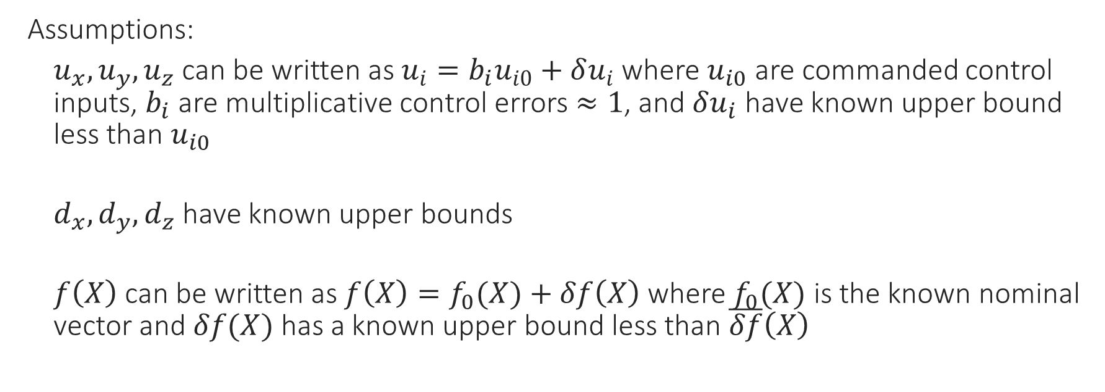
Dynamics
Assumptions:
$u_{x}, u_{y}, u_{z}$ can be written as $u_{i}=b_{i}u_{i0}+δu_{i}$ where $u_{i0}$ are commanded control inputs, $b_{i}$ are multiplicative control errors $≈1$, and $δu_{i}$ have known upper bound less than $u_{i0}$
$d_{x}, d_{y}, d_{z}$ have known upper bounds
$f\left(X\right)$ can be written as $f\left(X\right)=f_{0}(X)+δf\left(X\right)$ where $f_{0}(X)$ is the known nominal vector and $δf(X)$ has a known upper bound less than $\overline{δf}\left(X\right)$
Notes:
Control errors – b is approximately equal to 1, represents mass error or thrust error, $δu$ represents thrust noise
Disturbances – unmodeled dynamics (e.g. perturbations)
Model errors

Slide 15
Outline
Introduction to Formation Flying
Introduction to Sliding Mode Control
Objective of Project
Dynamics Model
Classical Sliding Surface
Alternative Sliding Surfaces
Nonsingular Terminal Sliding Surface
Simulations
Conclusions
Experiment

Slide 16
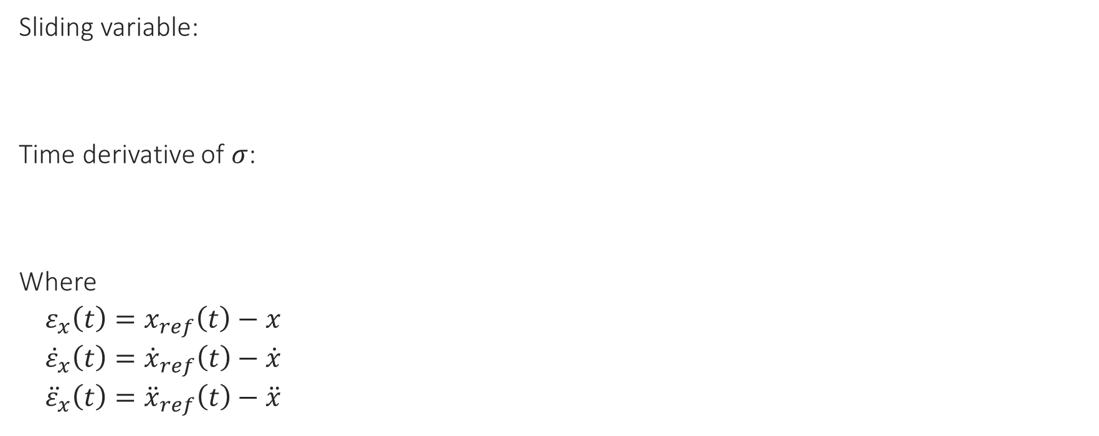

Classical Sliding Surface
Sliding variable:
Time derivative of $σ$:
Where
$ε_{x}\left(t\right)=x_{ref}\left(t\right)−x$
${\dot{ε}}_{x}\left(t\right)={\dot{x}}_{ref}\left(t\right)−\dot{x}$
${\ddot{ε}}_{x}\left(t\right)={\ddot{x}}_{ref}\left(t\right)−\ddot{x}$
$σ_{x}={\dot{ε}}_{x}+αε_{x}$, where $α>0$
$${\dot{σ}}_{x}={\ddot{ε}}_{x}+α{\dot{ε}}_{x}$$
Notes:
$ε\left(t\right)$ is the difference between the reference (desired) and true trajectories
$x_{ref}$ is the desired trajectory
Design a control structure to guarantee $ε_{x}\left(t\right)→0$ as $t→∞$

Slide 17
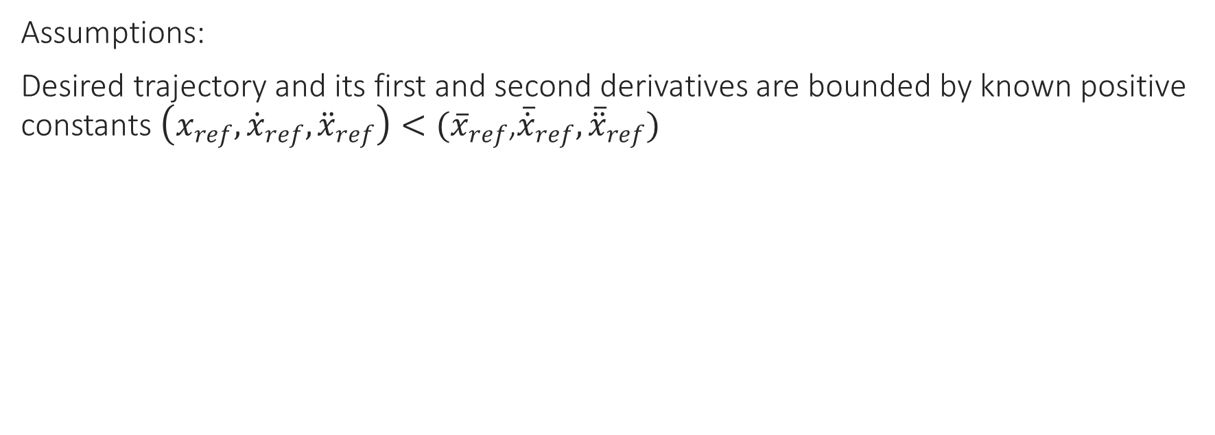
Classical Sliding Surface
Assumptions:
Desired trajectory and its first and second derivatives are bounded by known positive constants $\left(x_{ref},{\dot{x}}_{ref}, {\ddot{x}}_{ref}\right)<({\overline{x}}_{ref}$,${\overline{\dot{x}}}_{ref}, {\overline{\ddot{x}}}_{ref})$

Slide 18
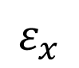
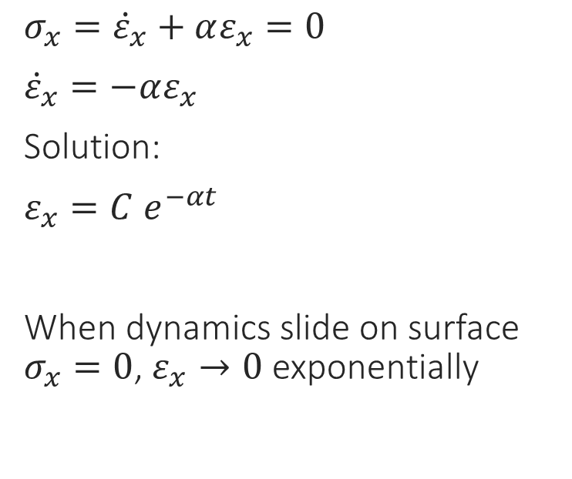

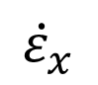
Classical Sliding Surface
$${\dot{ε}}_{x}$$
$σ_{x}={\dot{ε}}_{x}+αε_{x}=0$
${\dot{ε}}_{x}=−αε_{x}$
Solution:
$ε_{x}=C e^{−αt}$
When dynamics slide on surface $σ_{x}=0$, $ε_{x}→0$ exponentially
$$σ_{x}=0$$
$$ε_{x}$$

Slide 19
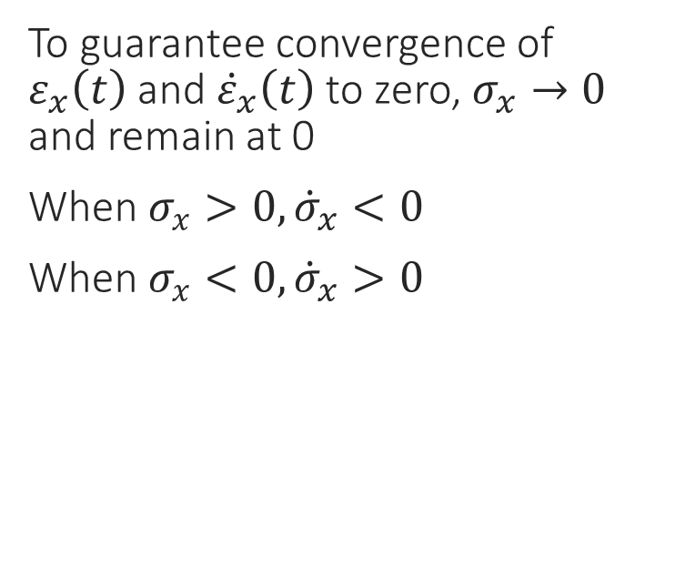
Classical Sliding Surface
$${\dot{ε}}_{x}$$
To guarantee convergence of $ε_{x}\left(t\right)$ and ${\dot{ε}}_{x}\left(t\right)$ to zero, $σ_{x}→0$ and remain at 0
When $σ_{x}>0, {\dot{σ}}_{x}<0$
When $σ_{x}<0, {\dot{σ}}_{x}>0$
$$σ_{x}=0$$
$$ε_{x}$$

Slide 20

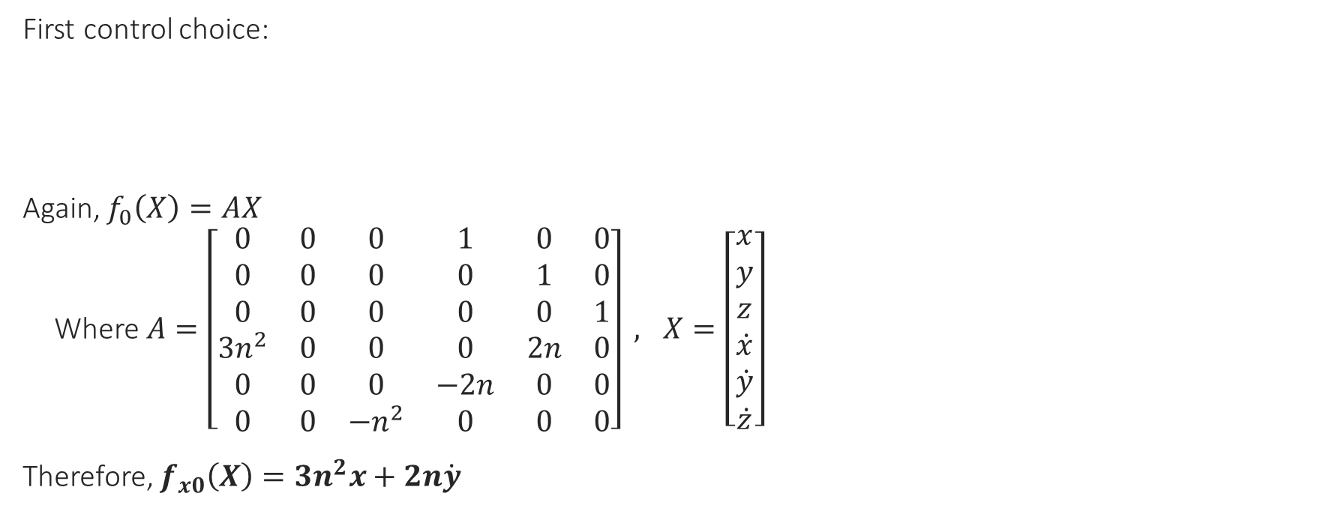
Classical Sliding Surface
First control choice:
Again, $f_{0}\left(X\right)=AX$
Where $A=\left[\begin{matrix}0 & 0 & 0 & 1 & 0 & 0 \\ 0 & 0 & 0 & 0 & 1 & 0 \\ 0 & 0 & 0 & 0 & 0 & 1 \\ 3n^{2} & 0 & 0 & 0 & 2n & 0 \\ 0 & 0 & 0 & −2n & 0 & 0 \\ 0 & 0 & −n^{2} & 0 & 0 & 0\end{matrix}\right] , X=\left[\begin{matrix}x \\ y \\ z \\ \dot{x} \\ \dot{y} \\ \dot{z}\end{matrix}\right]$
Therefore, $f_{x0}\left(X\right)=3n^{2}x+2n\dot{y}$
$$u_{x0}=k_{x} sign\left(σ_{x}\right)+α{\dot{ε}}_{x}−f_{x0}(X)$$

Slide 21
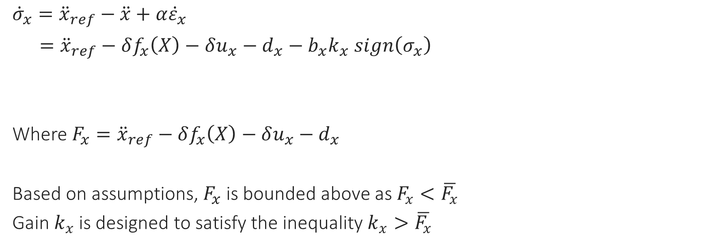

Classical Sliding Surface
${\dot{σ}}_{x}={\ddot{x}}_{ref}−\ddot{x}+α{\dot{ε}}_{x}$
$={\ddot{x}}_{ref}−δf_{x}\left(X\right)−δu_{x}−d_{x}−b_{x}k_{x} sign\left(σ_{x}\right)$
Where $F_{x}={\ddot{x}}_{ref}−δf_{x}\left(X\right)−δu_{x}−d_{x}$
Based on assumptions, $F_{x}$ is bounded above as $F_{x}<\overline{F_{x}}$
Gain $k_{x}$ is designed to satisfy the inequality $k_{x}>\overline{F_{x}}$
$${\dot{σ}}_{x}=−b_{x}k_{x}sign\left(σ_{x}\right)+F_{x}$$
Notes:
Since $k_{x}$is always greater than $\overline{F_{x}}$, $\dot{σ}$ will always be opposite in sign to $σ_{x}$, thus, the surface $σ_{x}=0$ can be reached anywhere. Once the states are on the sliding surface $σ_{x}=0$, and $ε_{x}$ exponentially decays to zero.

Slide 22
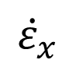
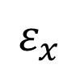

Classical Sliding Surface
Potential trajectory:
$${\dot{ε}}_{x}$$
$$σ_{x}=0$$
$$ε_{x}$$

Slide 23

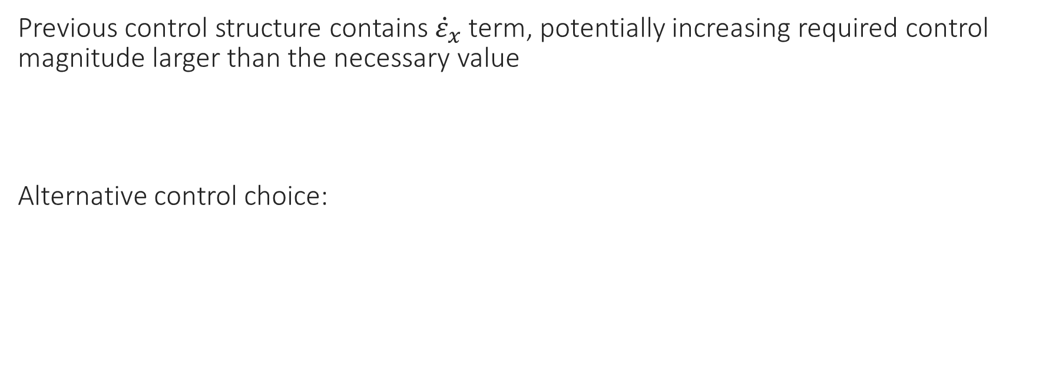

Classical Sliding Surface
Previous control structure contains ${\dot{ε}}_{x}$ term, potentially increasing required control magnitude larger than the necessary value
Alternative control choice:
$$u_{x0}=k_{x} sign\left(σ_{x}\right)+α{\dot{ε}}_{x}−f_{x0}(X)$$
$$u_{x0}=k_{x} sign\left(σ_{x}\right)−f_{x0}(X)$$

Slide 24
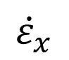
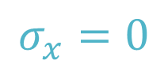
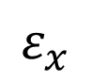

Classical Sliding Surface
Potential Trajectory:
$$σ_{x}=0$$
$${\dot{ε}}_{x}$$
(3)
(1)
$$k$$
*
*
$$ε_{x}$$
*
(2)

Slide 25
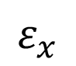
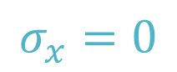
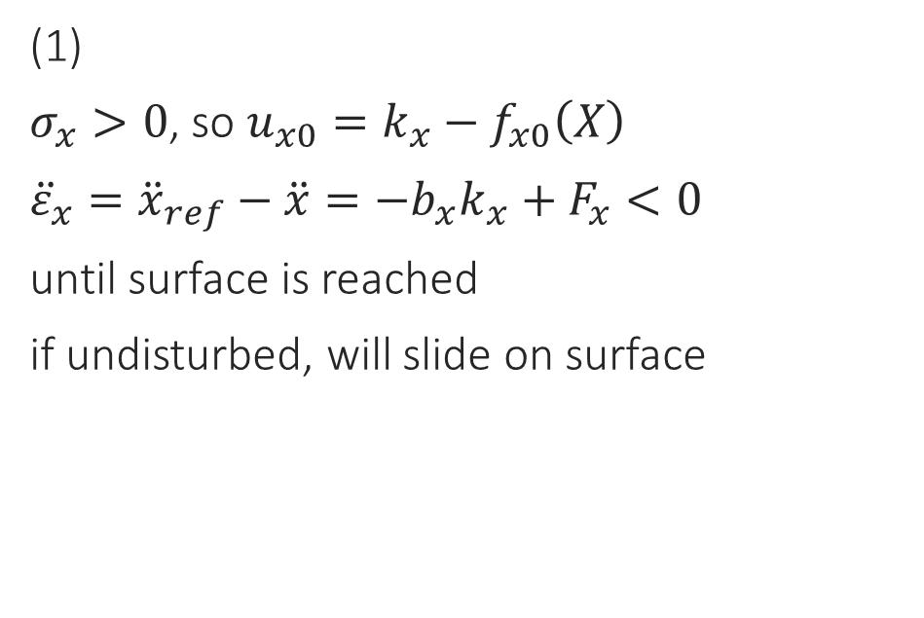
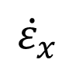
Classical Sliding Surface
(1)
$σ_{x}>0$, so $u_{x0}=k_{x}−f_{x0}\left(X\right)$
${\ddot{ε}}_{x}={\ddot{x}}_{ref}−\ddot{x}=−b_{x}k_{x}+F_{x}<0$
until surface is reached
if undisturbed, will slide on surface
$$σ_{x}=0$$
$${\dot{ε}}_{x}$$
(3)
(1)
$$k$$
*
*
$$ε_{x}$$
*
(2)

Slide 26
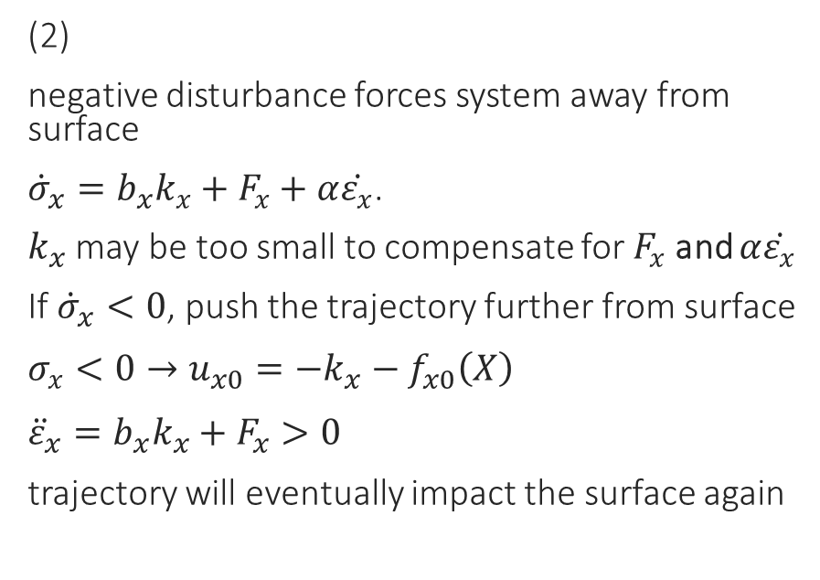
Classical Sliding Surface
(2)
negative disturbance forces system away from surface
${\dot{σ}}_{x}=b_{x}k_{x}+F_{x}+α\dot{ε_{x}}$.
$k_{x}$ may be too small to compensate for $F_{x}$ and $α\dot{ε_{x}}$
If ${\dot{σ}}_{x}<0$, push the trajectory further from surface
$σ_{x}<0→u_{x0}=−k_{x}−f_{x0}\left(X\right)$
${\ddot{ε}}_{x}=b_{x}k_{x}+F_{x}>0$
trajectory will eventually impact the surface again
$$σ_{x}=0$$
$${\dot{ε}}_{x}$$
(3)
(1)
$$k$$
*
*
$$ε_{x}$$
*
(2)

Slide 27
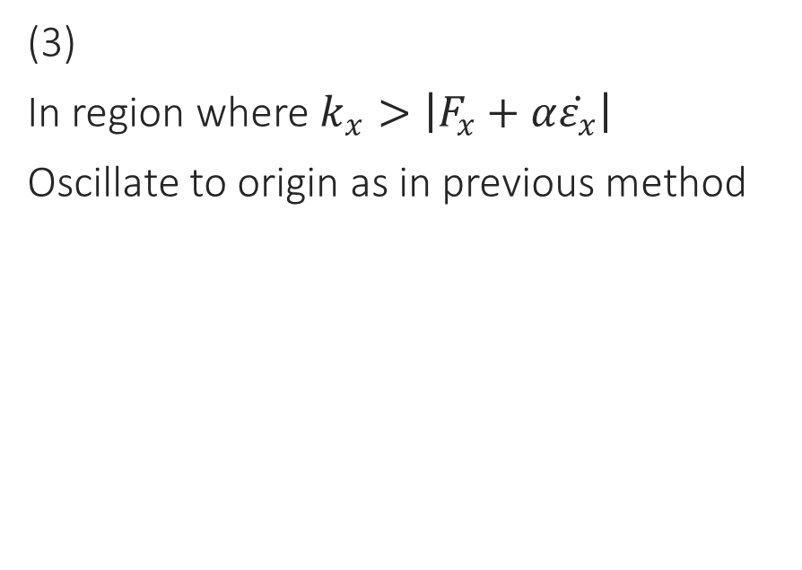

Classical Sliding Surface
(3)
In region where $k_{x}>\left|F_{x}+α\dot{ε_{x}}\right|$
Oscillate to origin as in previous method
$$σ_{x}=0$$
$${\dot{ε}}_{x}$$
(3)
*
(1)
$$k$$
*
$$ε_{x}$$
*
(2)
Notes:
Spiraling effect continues until in region where …

Slide 28
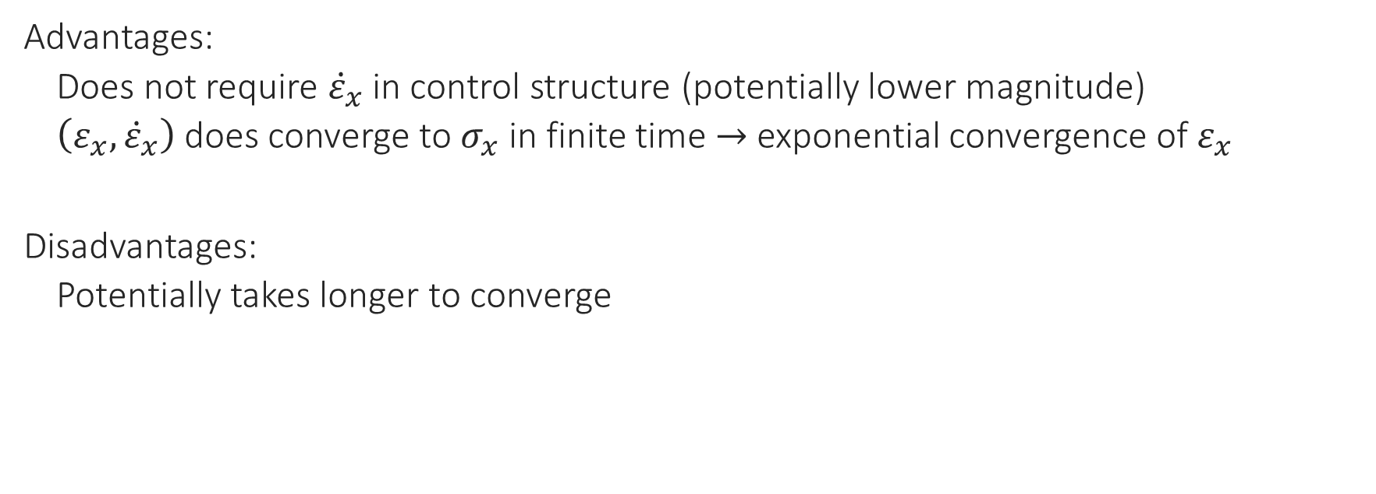
Classical Sliding Surface
Advantages:
Does not require ${\dot{ε}}_{x}$ in control structure (potentially lower magnitude)
$\left(ε_{x},{\dot{ε}}_{x}\right)$ does converge to $σ_{x}$ in finite time $→$exponential convergence of $ε_{x}$
Disadvantages:
Potentially takes longer to converge

Slide 29
Outline
Introduction to Formation Flying
Introduction to Sliding Mode Control
Objective of Project
Dynamics Model
Classical Sliding Surface
Alternative Sliding Surfaces
Nonsingular Terminal Sliding Surface
Simulations
Conclusions
Experiment

Slide 30
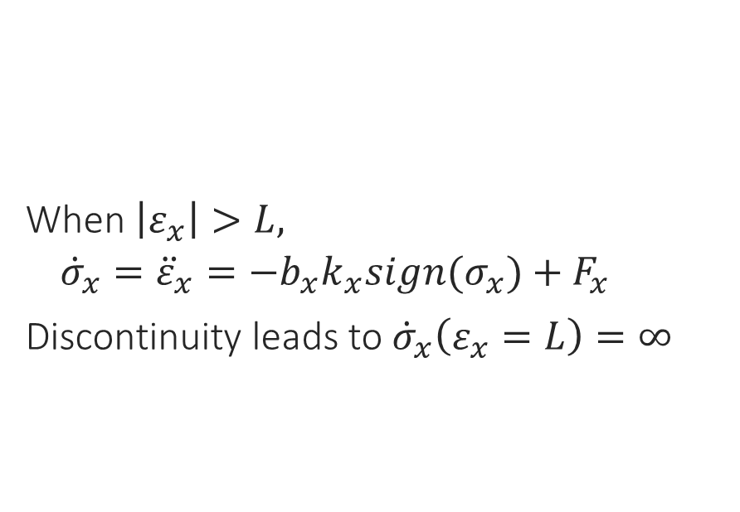
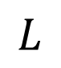
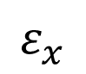
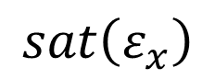

Alternative Sliding Surfaces
$$σ_{x}={\dot{ε}}_{x}+α sat\left(ε_{x}\right)$$
When $\left|ε_{x}\right|>L,$
${\dot{σ}}_{x}={\ddot{ε}}_{x}=−b_{x}k_{x}sign(σ_{x})+F_{x}$
Discontinuity leads to ${\dot{σ}}_{x}\left(ε_{x}=L\right)=∞$
$$sat\left(ε_{x}\right)$$
$$ε_{x}$$
$$L$$
Notes:
When $ε_{x}$ is large, ${\dot{σ}}_{x}$ does not include the ${\dot{ε}}_{x}$ term. Additionally, the state $\left(ε_{x},{\dot{ε}}_{x}\right)$ exponential convergence property is maintained. However, when $ε_{x}=L$ the discontinuity implies that $\frac{d}{dt}sat\left(ε_{x}\right)=∞$.

Slide 31
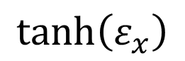

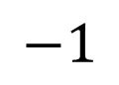
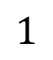
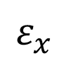
Alternative Sliding Surfaces
$$σ_{x}={\dot{ε}}_{x}+α\tanh\left(ε_{x}\right)$$
Eliminates discontinuity
Non-exponential convergence
$$tanh\left(ε_{x}\right)$$
$$1$$
$$ε_{x}$$
$$−1$$

Slide 32
Outline
Introduction to Formation Flying
Introduction to Sliding Mode Control
Objective of Project
Dynamics Model
Classical Sliding Surface
Alternative Sliding Surfaces
Nonsingular Terminal Sliding Surface
Simulations
Conclusions
Experiment

Slide 33
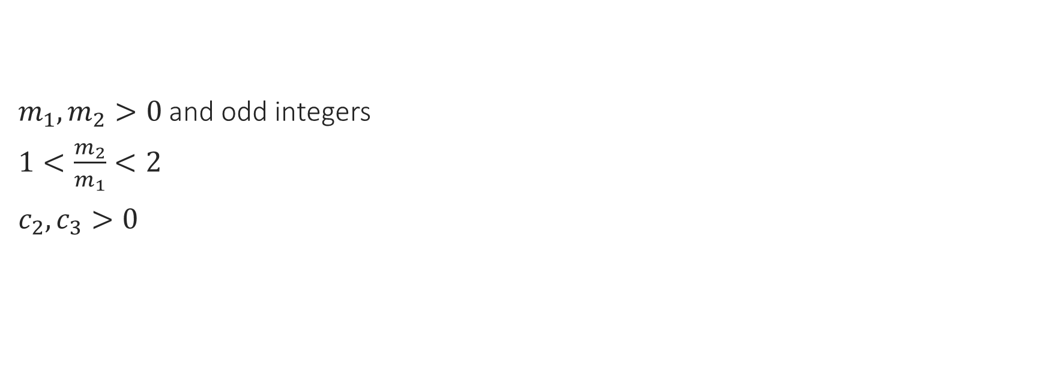
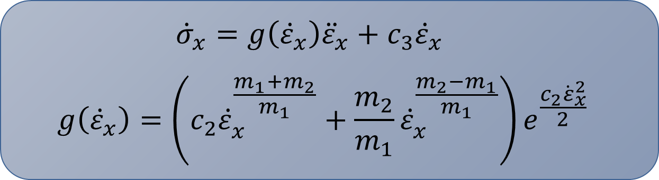

Nonsingular Terminal Sliding Surface
$$σ_{x}=e^{\frac{c_{2}ε_{x}^{2}}{2}}{\dot{ε}}_{x}^{\frac{m_{2}}{m_{1}}}+c_{3}ε_{x}$$
$m_{1}, m_{2}>0$ and odd integers
$1<\frac{m_{2}}{m_{1}}<2$
$c_{2},c_{3}>0$
$${\dot{σ}}_{x}=g\left({\dot{ε}}_{x}\right){\ddot{ε}}_{x}+c_{3}{\dot{ε}}_{x}$$
$$g\left({\dot{ε}}_{x}\right)=\left(c_{2}{\dot{ε}}_{x}^{\frac{m_{1}+m_{2}}{m_{1}}}+\frac{m_{2}}{m_{1}}{\dot{ε}}_{x}^{\frac{m_{2}−m_{1}}{m_{1}}}\right)e^{\frac{c_{2}{\dot{ε}}_{x}^{2}}{2}}$$
Notes:
regardless of the sign of ${\dot{ε}}_{x}$, the function $g\left({\dot{ε}}_{x}\right)$ is always positive because the exponential function is always positive and the exponents on ${\dot{ε}}_{x}$ can be evaluated as ${\dot{ε}}_{x}^{\frac{\left(m_{1}+m_{2}\right)}{m_{1}}}$ and ${\dot{ε}}_{x}^{\frac{\left(m_{2}−m_{1}\right)}{m_{1}}}$ where $\left(m_{1}+m_{2}\right)$ and $\left(m_{2}−m_{1}\right)$ are both positive integers.
Venkataraman, Control of Nonlinear Systems Using Terminal Sliding Modes, 1993

Slide 34
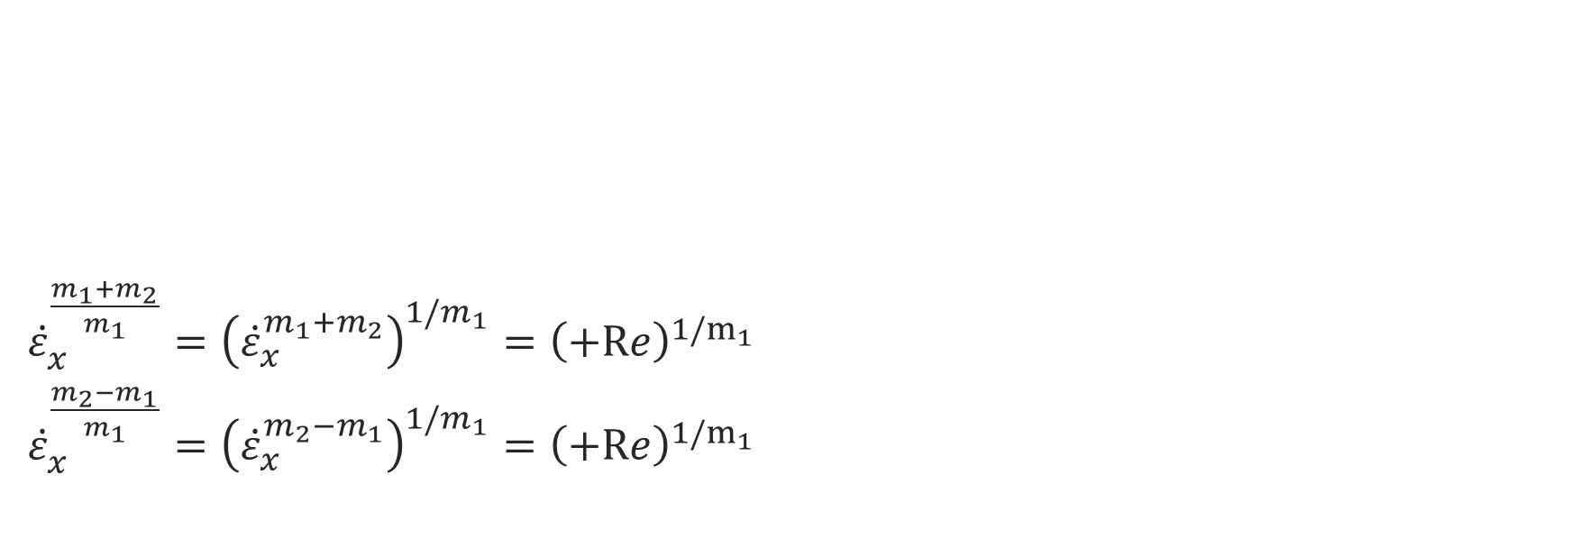
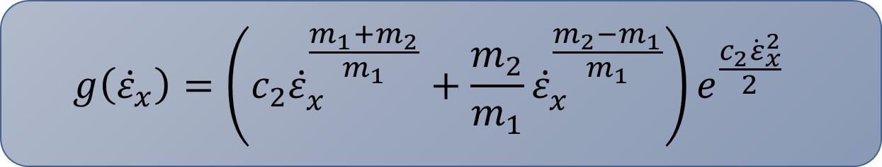
Nonsingular Terminal Sliding Surface
$$g\left({\dot{ε}}_{x}\right)=\left(c_{2}{\dot{ε}}_{x}^{\frac{m_{1}+m_{2}}{m_{1}}}+\frac{m_{2}}{m_{1}}{\dot{ε}}_{x}^{\frac{m_{2}−m_{1}}{m_{1}}}\right)e^{\frac{c_{2}{\dot{ε}}_{x}^{2}}{2}}$$
${\dot{ε}}_{x}^{\frac{m_{1}+m_{2}}{m_{1}}}={\left({\dot{ε}}_{x}^{m_{1}+m_{2}}\right)}^{1/m_{1}}={\left(+Re\right)}^{1/m_{1}}$
${\dot{ε}}_{x}^{\frac{m_{2}−m_{1}}{m_{1}}}={\left({\dot{ε}}_{x}^{m_{2}−m_{1}}\right)}^{1/m_{1}}={\left(+Re\right)}^{1/m_{1}}$
Notes:
regardless of the sign of ${\dot{ε}}_{x}$, the function $g\left({\dot{ε}}_{x}\right)$ is always positive because the exponential function is always positive and the exponents on ${\dot{ε}}_{x}$ can be evaluated as ${\dot{ε}}_{x}^{\frac{\left(m_{1}+m_{2}\right)}{m_{1}}}$ and ${\dot{ε}}_{x}^{\frac{\left(m_{2}−m_{1}\right)}{m_{1}}}$ where $\left(m_{1}+m_{2}\right)$ and $\left(m_{2}−m_{1}\right)$ are both positive integers.
Venkataraman, Control of Nonlinear Systems Using Terminal Sliding Modes, 1993

Slide 35
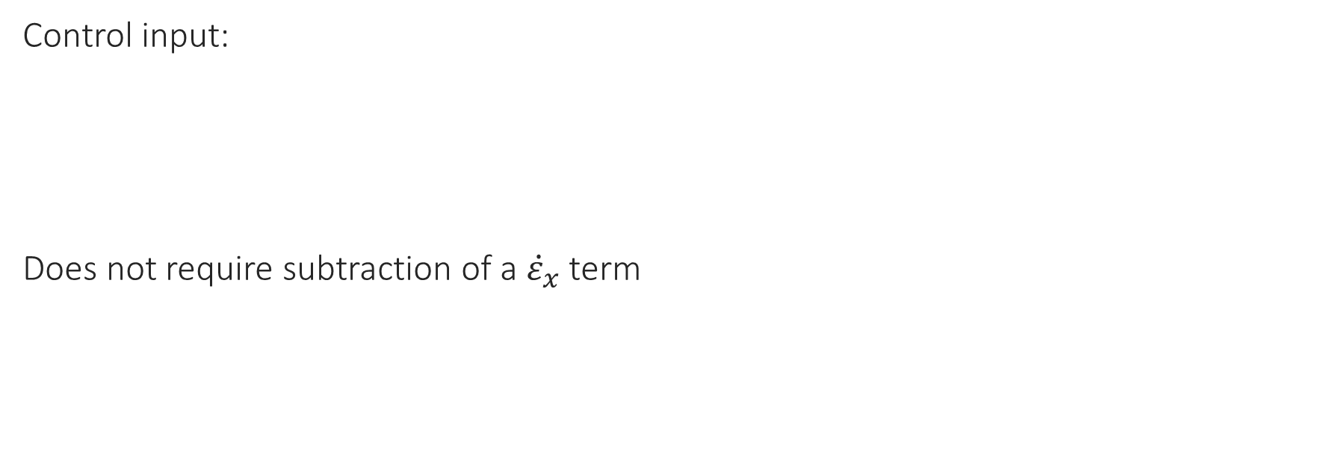

Nonsingular Terminal Sliding Surface
Control input:
Does not require subtraction of a ${\dot{ε}}_{x}$ term
$$u_{x0}=k_{1} sign\left(σ_{x}\right)−f_{x0}(X)$$

Slide 36
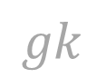
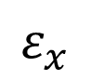

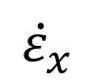
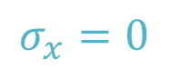
Nonsingular Terminal Sliding Surface
Potential Trajectory:
$${\dot{ε}}_{x}$$
*
(1)
$$σ_{x}=0$$
$$k$$
$$gk$$
$$ε_{x}$$
*
(2)

Slide 37
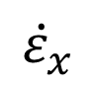
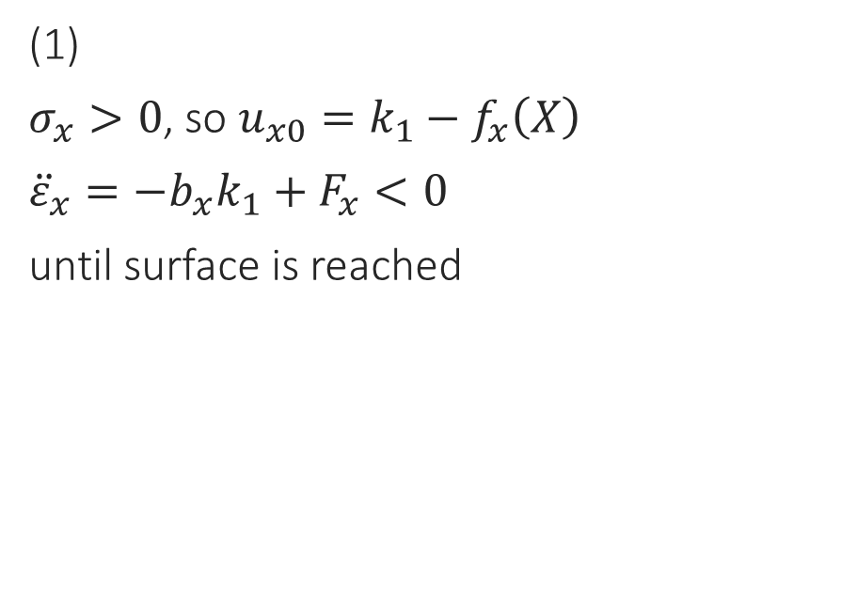


Nonsingular Terminal Sliding Surface
(1)
$σ_{x}>0$, so $u_{x0}=k_{1}−f_{x}\left(X\right)$
${\ddot{ε}}_{x}=−b_{x}k_{1}+F_{x}<0$
until surface is reached
$${\dot{ε}}_{x}$$
*
(1)
$$σ_{x}=0$$
$$k$$
$$gk$$
$$ε_{x}$$
*
(2)

Slide 38

Nonsingular Terminal Sliding Surface
(2)
negative disturbance forces system away from surface
${\dot{σ}}_{x}=g\left({\dot{ε}}_{x}\right)(−b_{x}k_{1}sign\left(σ_{x}\right)+F_{x})+c_{3}\dot{ε_{x}}$
$g\left({\dot{ε}}_{x}\right)$ can be designed such that $g\left({\dot{ε}}_{x}\right)k_{1}$ immediately dominates
system will slide on the surface, ensuring that $ε_{x}→0$
$${\dot{ε}}_{x}$$
*
(1)
$$σ_{x}=0$$
$$k$$
$$gk$$
$$ε_{x}$$
*
(2)
Notes:
a smaller control magnitude can still guarantee rapid convergence

Slide 39

Nonsingular Terminal Sliding Surface
Additional benefits:
Finite time convergence of $ε_{x}$ due to selection of $\frac{m_{2}}{m_{1}}$
Four constants (i.e. $m_{1},m_{2},c_{2},$ and $c_{3}$) can be tuned to yield desired performance characteristics
Use control that does not subtract ${\dot{ε}}_{x}$ term
No singularity as introduced in other attempts to avoid subtracting ${\dot{ε}}_{x}$ term
Notes:
as opposed to the linear surface with single constant $α$

Slide 40
Outline
Introduction to Formation Flying
Introduction to Sliding Mode Control
Objective of Project
Dynamics Model
Classical Sliding Surface
Alternative Sliding Surfaces
Nonsingular Terminal Sliding Surface
Simulations
Conclusions
Experiment
Notes:
In this section, it will be shown through simulations that the nonsingular terminal sliding mode controller can quickly and effectively force the system to match a desired set of reference dynamics in finite time in the presence of exogenous disturbance and uncertainty in the control input.

Slide 41
Simulations
Propagated 2 satellites’ nonlinear equations of motion separately
In Earth centered inertial (ECI) frame
Included J2 perturbation
Calculated x, y, and z components at each time step for computation of control inputs
Notes:
The satellites’ nonlinear equations of motion, which included the J2 perturbation, were propagated in Earth-centered inertial (ECI) frame separately, and the LVLH components were calculated at each time step for use in the computation of control components.

Slide 42



Simulations
Initial conditions and parameters
Chief initial orbital elements:
Initial relative state:
Control parameters:
a (km) | e (dim) | i (dim) | $Ω$ (rad) | $ω$ (rad) | $M_{0}$ (rad)
$R_{Earth}$+300 | 0.1 | 0 | $$π/4$$ | $$π/6$$ | 0
$x_{0}$ (km) | $y_{0}$ (km) | $z_{0}$ (km) | ${\dot{x}}_{0}$ (km/s) | ${\dot{y}}_{0}$ (km/s) | ${\dot{z}}_{0}$ (km/s)
10 | 5 | 5 | 0 | 0 | 0
$c_{2}, c_{3}$ (dim) | $m_{1}$ (dim) | $m_{2}$ (dim) | $k_{i}$ (N)
0.1 | 3 | 5 | 1.0
Notes:
chaser satellite is assumed to have 1 kg unit mass

Slide 43


Simulations
Error magnitudes:
Disturbances: $d_{i}$
Thrust error: multiplicative ($b_{i}$) and noise ($δu_{i}$)
$u_{i}=b_{i}u_{i0}+δu_{i}$
Disturbance ($m/s^{2}$) | $b_{i}$ (dim) | $δu_{i}$ (N)
0.01 | 0.9 | 0.1
Notes:
Both the disturbance and thrust noise ($δu$) are multiplied my a normally distributed random value at each timestep in the simulation.

Slide 44


Simulations
Relative orbit components
Satellite trajectories in ECI frame
Notes:
Dynamics propagated for span of 1 chief orbit (5431 sec).
Lvlh components with reference trajectory
Chief and chaser trajectories in ECI
Closely tracks reference

Slide 45




Simulations
Error in relative orbit components, $ε$
Sliding variable components, $σ$
Notes:
Tracking error.
Sliding variable over time.
Sliding variable goes to zero, causing the tracking error to go to zero
Dynamics track reference to within a few meters over the span of a single orbit

Slide 46


Simulations
Control input components, u
Total $ΔV$ over one orbit
Notes:
Control input over time as it adapts to uncertainty and external disturbance
Total delta-V

Slide 47

Simulations
Error magnitude was then varied to determine the range of values that can be compensated by the controller
Maximum error for each error type still resulting in convergence of x, y, and z:
Disturbance ($m/s^{2}$) | $b_{i}$ (dim) | $δu_{i}$ (N)
0 – 0.05 | 0.75 - 1 | 0 - 0.2

Slide 48
Simulations
When errors are combined, convergence is achieved over a smaller range of error magnitudes
Convergence of sampled error combinations
Notes:
Combinations of errors sampled linearly along the range given in TABLE IV were applied to the simulation. Figure 12 shows the points on that range which result in convergence. Where points are missing from the sampled pattern, the combined errors resulted in non-convergence.

Slide 49
Outline
Introduction to Formation Flying
Introduction to Sliding Mode Control
Objective of Project
Dynamics Model
Classical Sliding Surface
Alternative Sliding Surfaces
Nonsingular Terminal Sliding Surface
Simulations
Conclusions
Experiment

Slide 50
Conclusions
Nonsingular terminal sliding mode control scheme is effective for control of a formation flying satellite system with a range of disturbances and uncertainties
Simulation results demonstrate successful performance
Discontinuous control function is difficult and expensive for onboard implementation

Slide 51
Thank you. Questions?
Maggie Lawn

Slide 52
Outline
Introduction to Formation Flying
Introduction to Sliding Mode Control
Objective of Project
Dynamics Model
Classical Sliding Surface
Alternative Sliding Surfaces
Nonsingular Terminal Sliding Surface
Simulations
Conclusions
Experiment

Slide 53


Experiment
Simulate orbital motion of the spacecraft in the $x−y$ plane
Dynamics were scaled down to the lab frame and used to obtain the wheel velocity and command inputs
1 orbital period in the spacecraft frame = 60s in the lab frame
1km in the spacecraft frame = 1m in the lab frame
Control parameters:
$c_{2}, c_{3}$ (dim) | $m_{1}$ (dim) | $m_{2}$ (dim) | $k_{i}$(N)
0.1 | 3 | 5 | 1.0
Notes:
To demonstrate the effectiveness of the proposed control structure, an experiment is carried out with an omni-directional robot to simulate spacecraft dynamics.
the disturbance and parametric uncertainty were due to imperfection on the floor, e.g. bumps, and uncertainty in the wheel model, respectively.

Slide 54

Experiment
Robot’s trajectory with desired trajectory

Slide 55


Experiment
Robot’s position error
Robot’s velocity error
Notes:
all the error goes to zero in finite and remains at zero in the presence of uncertainty and disturbance

Slide 56


Experiment
Sliding variable evolution over time
Robot’s commanded control input
Notes:
Sliding variable goes to zero, causing the tracking error to go to zero

Slide 57


Proof
Lyapunov candidate function:
$\dot{V}=σ_{x}\left(g\left({\dot{ε}}_{x}\right){\ddot{ε}}_{x}+c_{3}{\dot{ε}}_{x}\right)$
$=σ_{x}\left(g\left({\dot{ε}}_{x}\right)\left(−k_{1}sign\left(σ_{x}\right)−F_{x}\right)+c_{3}{\dot{ε}}_{x}\right)$
$≤σ_{x}\left(g\left({\dot{ε}}_{x}\right)k_{2}sign\left(σ_{x}\right)+c_{3}{\dot{ε}}_{x}\right)$
Where $k_{2}=k_{1}−{\overline{F}}_{x}$
$$V=\frac{1}{2}σ_{x}^{2}$$

Slide 58

Proof
$\dot{V}≤σ_{x}\left(g\left({\dot{ε}}_{x}\right)k_{2}sign\left(σ_{x}\right)+c_{3}{\dot{ε}}_{x}\right)$
From definition of $g\left({\dot{ε}}_{x}\right)=\left(c_{2}{\dot{ε}}_{x}^{\frac{m_{1}+m_{2}}{m_{1}}}+\frac{m_{2}}{m_{1}}{\dot{ε}}_{x}^{\frac{m_{2}−m_{1}}{m_{1}}}\right)e^{\frac{c_{2}{\dot{ε}}_{x}^{2}}{2}}$,
$g\left({\dot{ε}}_{x}\right)≥c_{3}{\dot{ε}}_{x}$ when $c_{3}≤k_{2}\min\left(c­_{2},\frac{m_{2}}{m_{1}}\right)$
Hence $\dot{V}≤0$ when ${\dot{ε}}_{x}≠0$
Notes:
$c_{3}$ is a design choice, as is $c_{2}$ and $m_{1}$ and $m_{2}$.

Slide 59

Proof
When ${\dot{ε}}_{x}=0$,
Error dynamics reduce to ${\ddot{ε}}_{x}=−k_{1} sign\left(σ_{x}\right)+F_{x}$
Proof in A. Goodyear, P. Christophe, P. Jean, Z. Costantinos, B. Morgan, I. Kolmanovsky, "Hardware implementation of Model Predictive Control for relative motion maneuvering," American Control Conference (ACC), 2015. IEEE, 2015.
When ${\dot{ε}}_{x}=0$ the sign of the acceleration is equivalent to $sign\left(\ddot{ε_{x}}\right)=−k_{1}sign\left(σ_{x}\right)$
Hence, the line $\dot{ε_{x}}=0$ is an unattractive set
Therefore, the surface $σ_{x}=0$ can be reached everywhere

Slide 60
Robot Details
A. Goodyear, P. Christophe, P. Jean, Z. Costantinos, B. Morgan, I. Kolmanovsky, "Hardware implementation of Model Predictive Control for relative motion maneuvering," American Control Conference (ACC), 2015. IEEE, 2015.
time-varying position of the robot with respect to the inertial lab frame was measured using VICON Motion Capture Systems
control algorithm is developed in Simulink, which used auto code generation to embed the algorithm onto the Beaglebone Black
The Beaglebone Black receives the position of the robot in the lab frame and send the wheel command control signal to the robot
All the calculations are performed on the Beaglebone Black. This hardware is chosen due to its computation limitation similar to those on small spacecraft

Slide 61
Benefits to SMC
dynamic behavior of the system may be tailored by the particular choice of the sliding function
closed loop response becomes totally insensitive to some particular uncertainties. This principle extends to model parameter uncertainties, disturbance and nonlinearity that are bounded
From a practical point of view SMC allows for controlling nonlinear processes subject to external disturbances and heavy model uncertainties

